Slide 1
MedXFormer Cross-Specialty Disease Diagnosis for Improved Clinical Outcomes
Authors: Charvi Kusuma and Tarun Reddi
Notes:
ID=d924773e-9a16-4d6d-9803-8cb819e99682 Recipe=text_billboard Type=TextOnly Variant=0 FamilyID=AccentBoxWalbaum_Zero

Slide 2
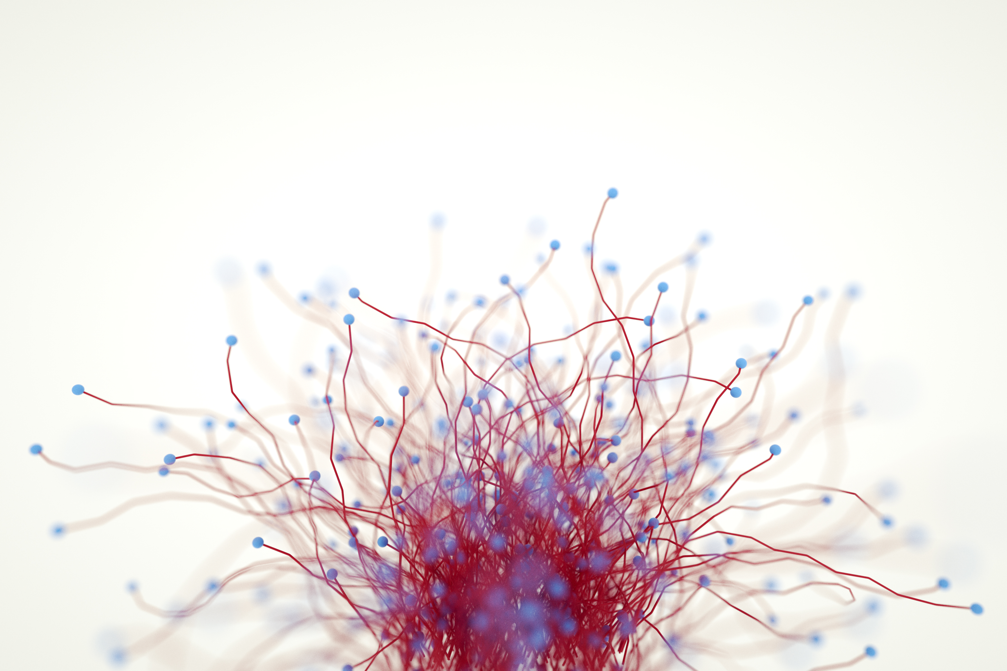
Project Overview
Objective: Develop a unified model for diagnosing skin cancer, brain tumors, retinal disorders, diabetic complications, and kidney abnormalities.
State of the Art: Latest PEFT techniques (LoRA, AdaLoRA, LoHA, etc.) and advanced preprocessing methods.
Inputs/Outputs:
Inputs: MRI, OCT, dermatoscopy, fundus, and ultrasound images.
Outputs: Predicted labels and confidence scores.
Contributions: Unified model with diverse datasets, efficient fine-tuning, and preprocessing pipeline.

Slide 3
Approach
Core Algorithms
Vision Transformer (ViT): Base model for classification.
Preprocessing Filters:
CLAHE for contrast enhancement.
Gaussian Blur for noise reduction.
Canny Edge Detection for edge highlighting.
PEFT Techniques: LoRA, AdaLoRA, LoHA, LoKr, IA3.
Strengths: High accuracy and efficiency.
Challenges: Computational demands and dataset sensitivity.
Key Components:
Custom preprocessing pipelines for dataset-specific optimization.
PEFT adapter integration for task-specific fine-tuning.
Unified training, evaluation, and inference pipelines.
Online Resources:
Hugging Face for ViT and PEFT implementations.
OpenCV for image filters.PyTorch for metrics and loss functions.

Slide 4
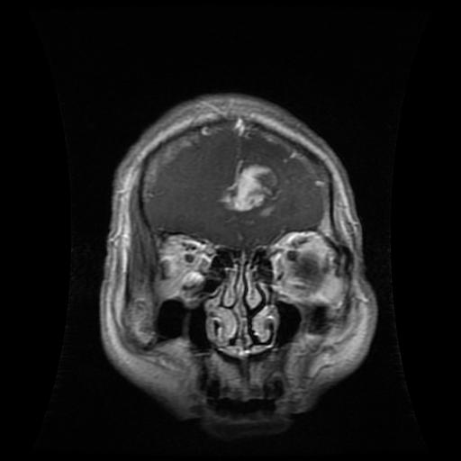
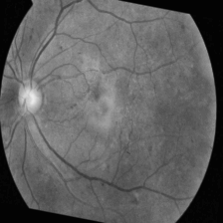
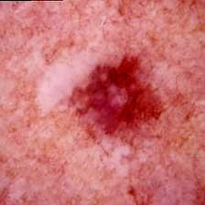
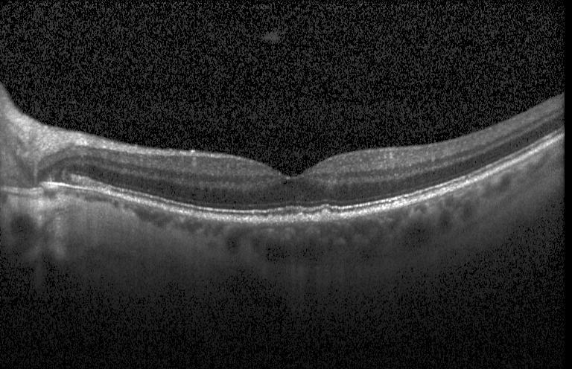
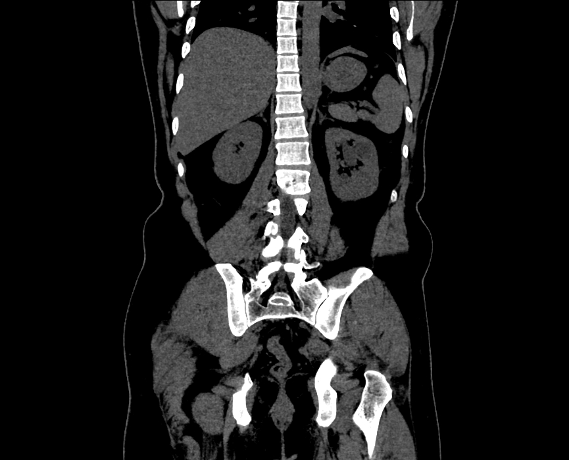
Experimental Protocol
Datasets
Brain Tumor | Diabetic Retinopathy | Skin Cancer | Retina | Kidney
Evaluation Metrics
Accuracy, Precision, Recall, F1, Confidence Scores.
Compute Resources
NVIDIA H100 (32GB) 16 hours of training.
~19 GB training data. 0.3ms inference time per image on CPU.

Slide 5
Results

Slide 6
Results

Slide 7
Analysis
Dataset Challenges:
Low contrast or imbalanced data impacts performance.
Subtle features in skin cancer and diabetic datasets pose difficulties.
Algorithmic Trade-offs:
LoRA and LoHA balance efficiency and performance effectively.
Preprocessing impacts:
Significant for diabetic, less for skin cancer.
Overall Takeaways:
Unified approach excels in scalability and adaptability.
Modular design makes it deployable in low-resource environments.
Key Lessons:
Unified, modular systems reduce model redundancy and enhance scalability.
PEFT techniques are effective for resource-limited scenarios but need careful tuning for dataset variability.
Preprocessing pipelines are critical for datasets with low signal-to-noise ratios.
Applications of Insights:
Modular design principles can extend to other domains, such as industrial defect detection or satellite imagery.
Scalability supports deployment in low-resource settings.
Future iterations can incorporate explainability and LLMs for detailed diagnostic reports.

Slide 8

Summary
Potential Future Directions
Immediate Enhancements:
Extend to additional imaging modalities and disease types.
Combine with small-scale LLMs for generating diagnostic insights.
Long-Term Applications:
Real-time diagnostic assistance for clinicians.
Adaptation to other fields requiring multi-task systems, e.g., anomaly detection.

Slide 9
Diverse Datasets Trained and tested on five distinct medical imaging datasets, covering a wide range of tasks. Unified Model Developed a single model with adapters for seamless task-specific alignment, unlike traditional approaches requiring separate models for each task. PEFT Analysis Implemented and evaluated five PEFT techniques (LoRA, LoKr, LoHA, AdaLoRA, IA3), offering efficient fine-tuning compared to traditional full-model training or resource-heavy ensemble methods.
Novelty

Slide 10


Thank you
References
Research Papers
Vision Transformers in Medical Imaging: A Comprehensive Survey, Gupta, S., et al, 2023.
LoRA: Low-Rank Adaptation of Large Language Models, Hu, E., et al, 2022.
Transformers for Image Recognition at Scale, Dosovitskiy, A., et al, 2021.
ViT for Kidney Cyst, Stone, and Tumor Detection, Scientific Reports, Islam, M.N., et al, 2022.
Medical Imaging Datasets
Skin Cancer: ISIC 2019 Challenge (ISIC), Kaggle.
Brain Tumor: Kaggle, PMC.
Retina OCT: Kaggle, PMC.
Diabetic Retinopathy: Kaggle.
Kidney: Kaggle.
Libraries and Tools
Transformers & PEFT: Hugging Face.
Image Processing: OpenCV.
Metrics: PyTorch.
Presentators
Charvi Kusuma
Tarun Reddi
This presentation is part of the final project for the CSE 573 course on Computer Vision and Image Processing.

